Slide 1
Introduction to Unsupervised Learning

Slide 2
Outline
Supervised vs Unsupervised Learning
How unsupervised Learning works
Approaches of Unsupervised Learning
Types of unsupervised problems

Slide 3
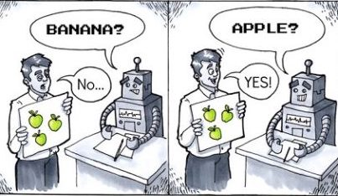
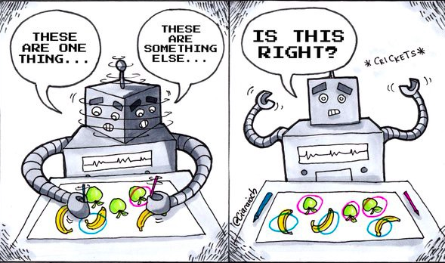
Supervised Learning
Unsupervised Learning

Slide 4



Supervised Learning | Unsupervised Learning
Computer learns by making use of labeled data | Computer learns by making use of unlabeled data
Requires manual annotation of data | Does not require annotation of data
Apple
???
Mango
Grapes
???
???

Slide 5

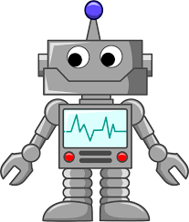
Why do we need to use unlabeled data?

Slide 6
For example, if we have an unlabeled dataset of images of animals and we would like train a model that classifies if an animal is a bird, reptile and a mammal

Slide 7
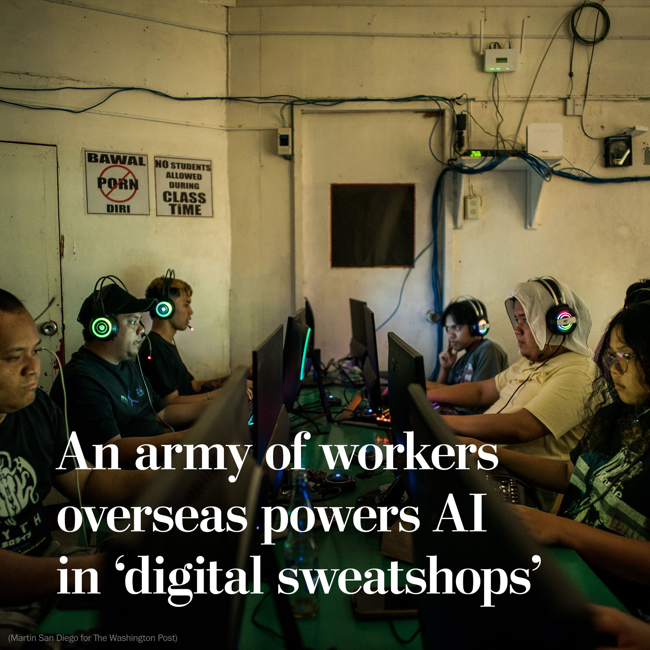
Data Annotation
Data annotation is the process of labeling data such as text, images, audio or video so that it can be used to train machine learning models.
The cost of annotating data varies and is very labor intensive. Some annotation tasks such as labeling medical images costs higher because it requires domain expertise.

Slide 8
The Cost of Data Annotation
Unfortunately, companies exploit people from the global south and pay these unregulated workers at extremely low rates and sometimes do not pay them at all.

Slide 9
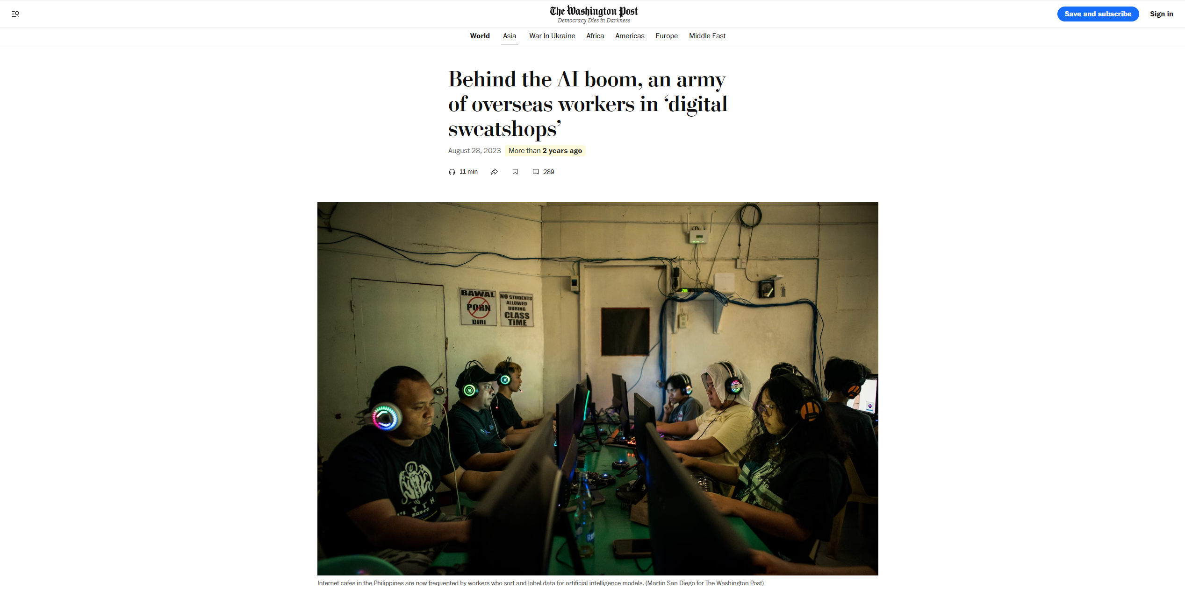
https://www.washingtonpost.com/world/2023/08/28/scale-ai-remotasks-philippines-artificial-intelligence/

Slide 10
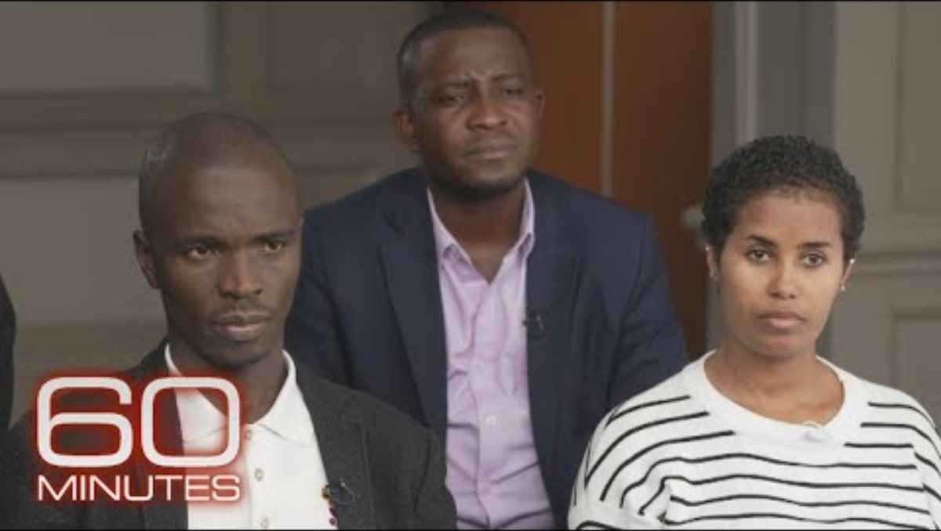
The human cost of training AI

Slide 11
If the data is not labeled, how will the model learn?

Slide 12
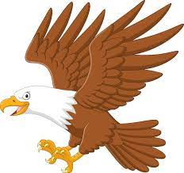
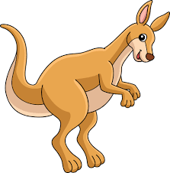
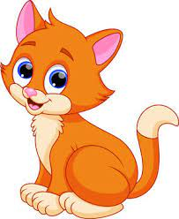
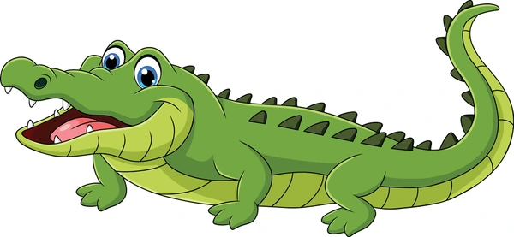
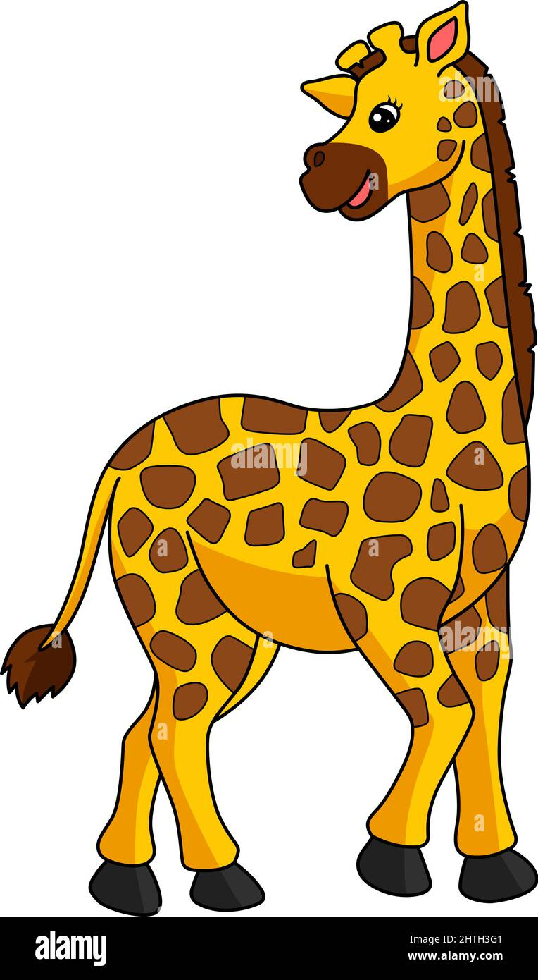

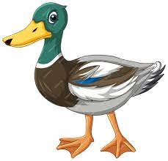
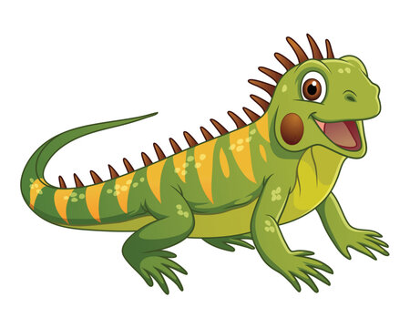
For example, if we have an unlabeled dataset of images of animals and we would like train a model that classifies if an animal is a bird, reptile and a mammal

Slide 13
Since our data is unlabeled and we do not have a way of knowing what class they belong to, we could start by finding similar features that the animals share.

Slide 14
First, since all birds have beaks and feathers, we can start looking at each image and see if they have beaks and feathers.

Slide 15
If an image have these features, we group them together

Slide 17
Next, since reptiles have scales, we look at each image and check if they have this feature.

Slide 18
If an image have this feature, we group them together

Slide 20
And since mammals all have fur, we look at each image and check if they have this feature.

Slide 21
If an image have this feature, we group them together

Slide 22
Group with feathers
Group with scales
Group with fur
We now have grouped each image and created three groups

Slide 23
Group with feathers
Group with scales
Group with fur
We now have grouped each image and created three groups

Slide 24
Group with feathers
Group with scales
Group with fur
This method of grouping similar objects together is called clustering

Slide 25
Group with feathers
Group with scales
Group with fur
In clustering, a group of similar objects is called a cluster.

Slide 26
Group with feathers
Group with scales
Group with fur
Similar objects are grouped into one cluster and are different from objects in another cluster.

Slide 27
Group with feathers
Group with scales
Group with fur
Clustering is one of the main approaches used in supervised learning.

Slide 28
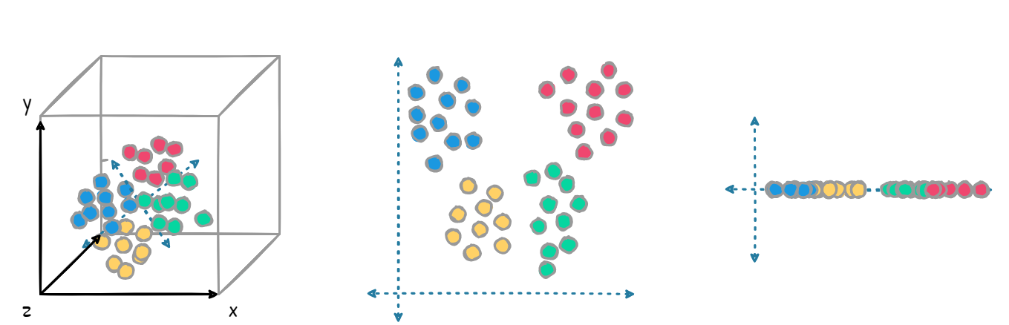
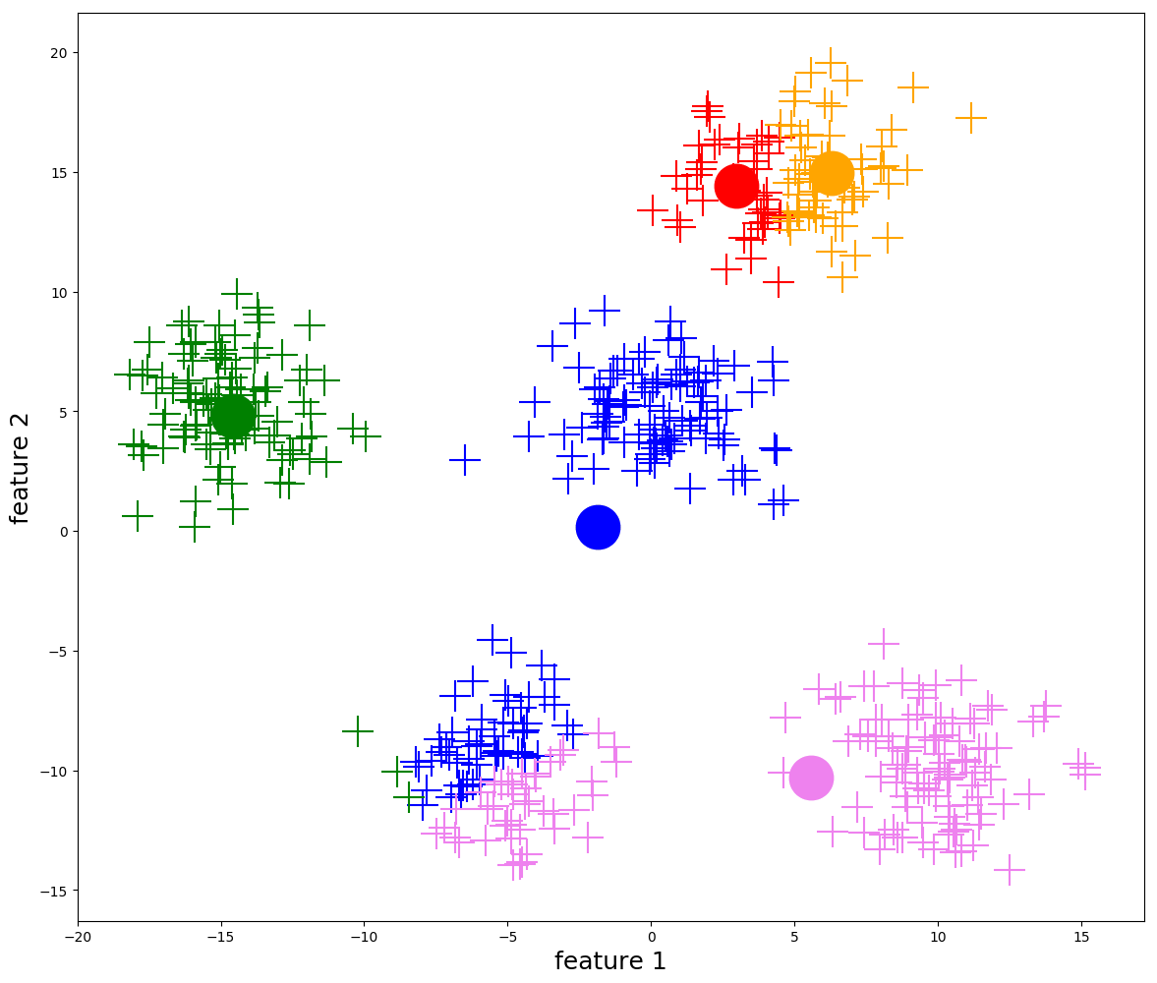
Dimensionality Reduction
Clustering
Other unsupervised learning approaches include dimensionality reduction and association rule learning.

Slide 29
Other unsupervised learning approaches include dimensionality reduction..

Slide 30
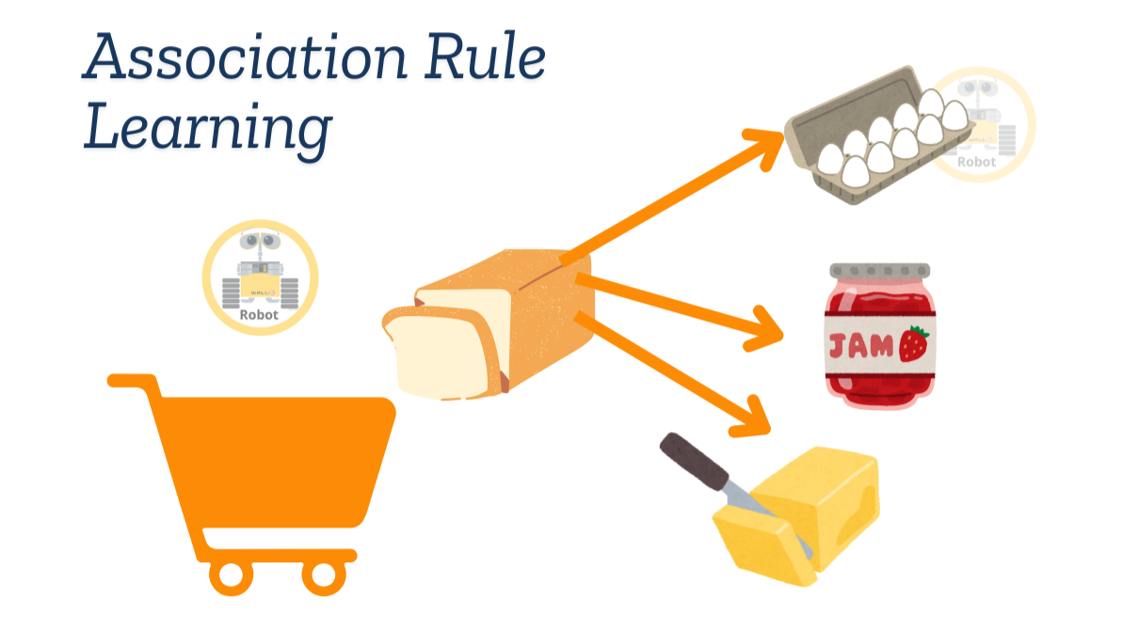
And association rule learning.

Slide 31
Applications of Unsupervised Learning
News Sections: Google News uses unsupervised learning to categorize articles on the same story from various online news outlets. For example, the results of a presidential election could be categorized under their label for “US” news.
Computer vision: Unsupervised learning algorithms are used for visual perception tasks, such as object recognition.
Medical imaging: Unsupervised machine learning provides essential features to medical imaging devices, such as image detection, classification and segmentation, used in radiology and pathology to diagnose patients quickly and accurately.
Anomaly detection: Unsupervised learning models can comb through large amounts of data and discover atypical data points within a dataset. These anomalies can raise awareness around faulty equipment, human error, or breaches in security.
Customer personas: Defining customer personas makes it easier to understand common traits and business clients' purchasing habits. Unsupervised learning allows businesses to build better buyer persona profiles, enabling organizations to align their product messaging more appropriately.
Recommendation Engines: Using past purchase behavior data, unsupervised learning can help to discover data trends that can be used to develop more effective cross-selling strategies. This is used to make relevant add-on recommendations to customers during the checkout process for online retailers.

Slide 32
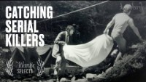
How clustering helped tracked a killer

Slide 33
References
https://www.ibm.com/think/topics/unsupervised-learning

